Slide 1
Savannah’s Thesis Graphs Progress
Elevations and Sediment Deposition Over Months and Distances (M1-M6!)

Slide 2
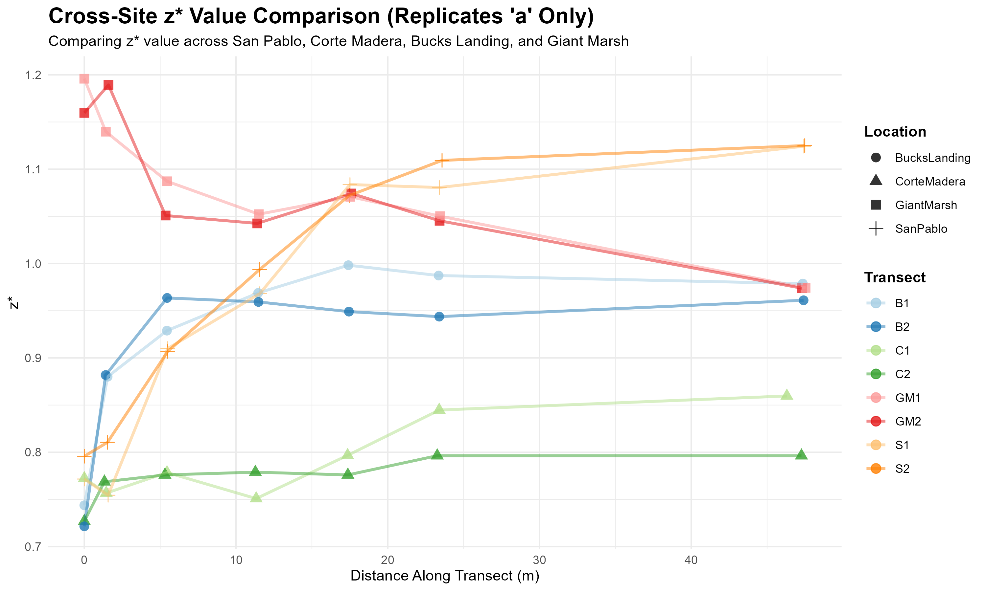

Slide 3
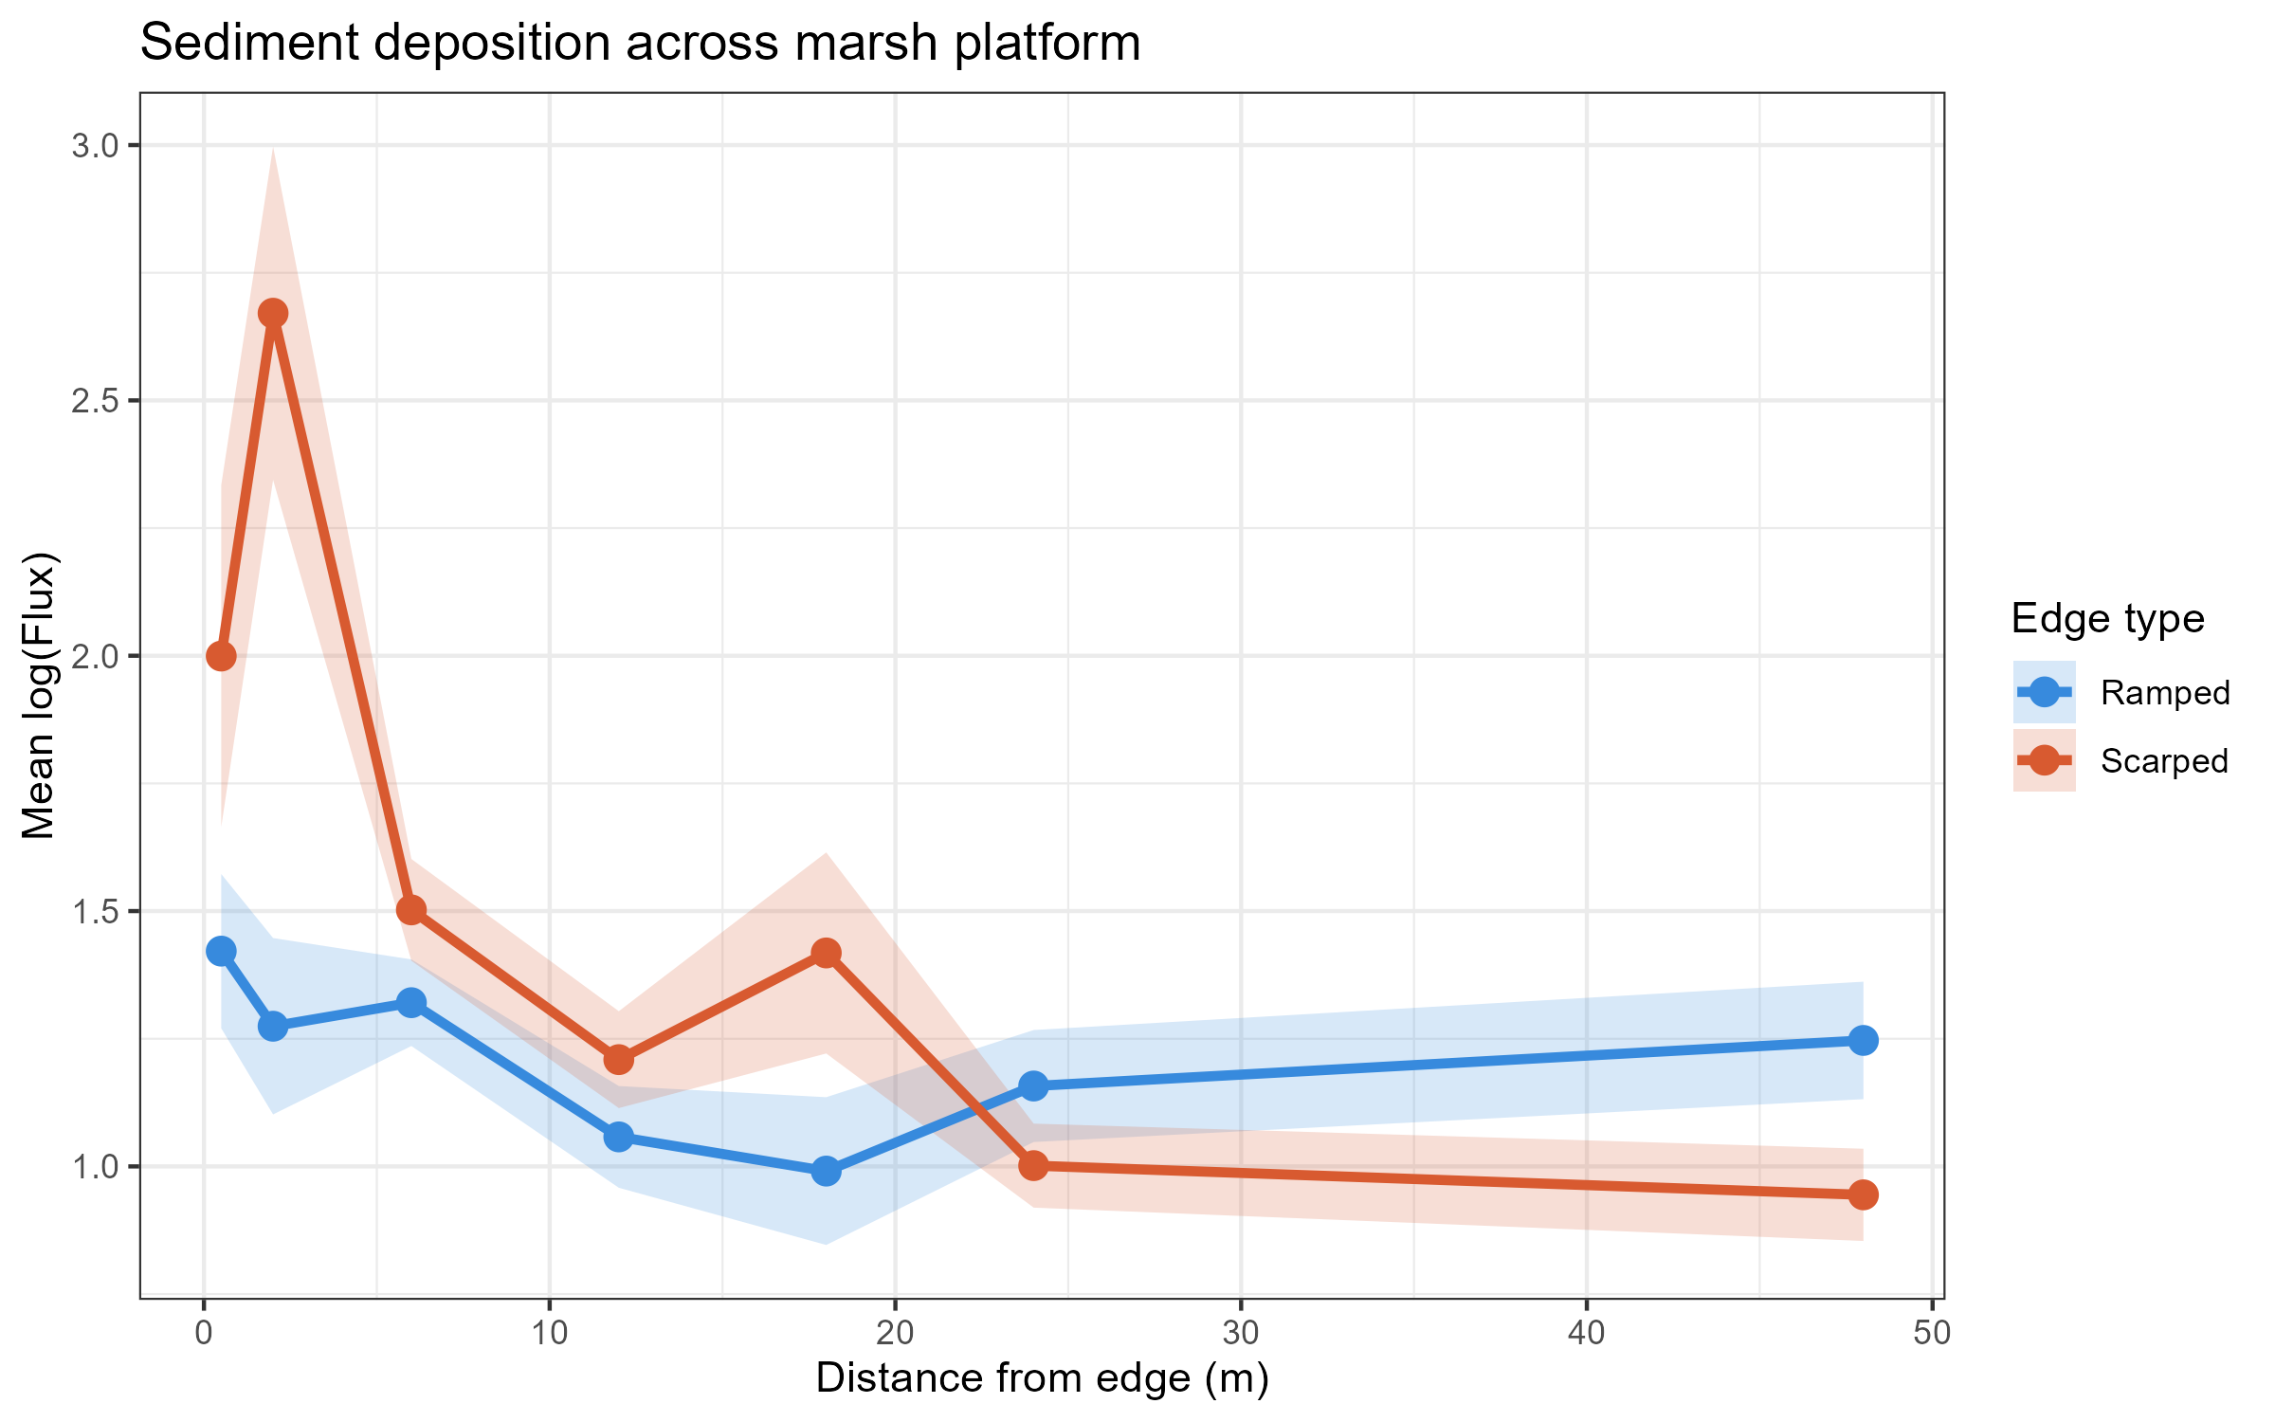

Slide 4
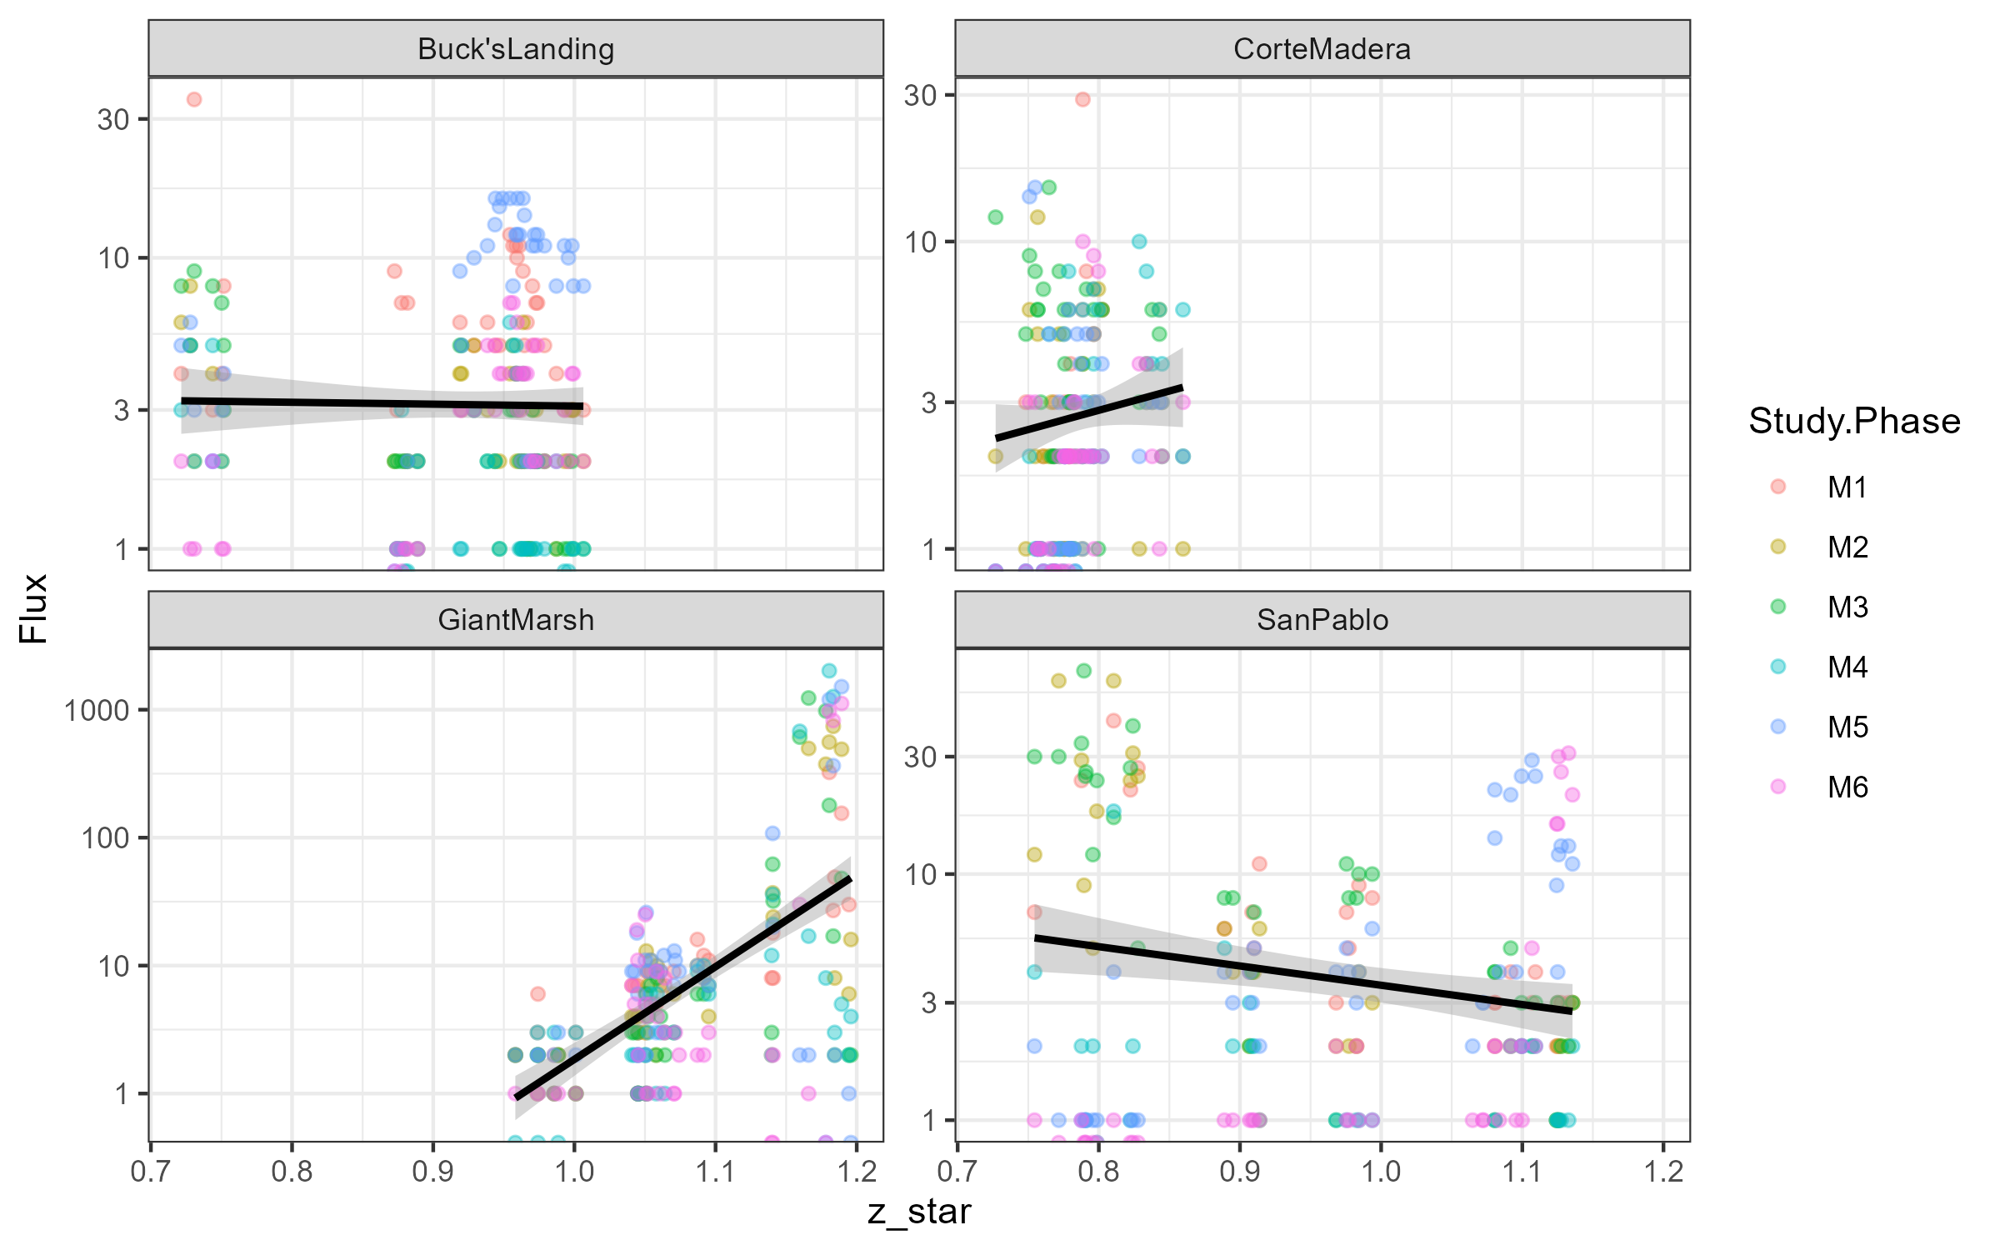

Slide 5
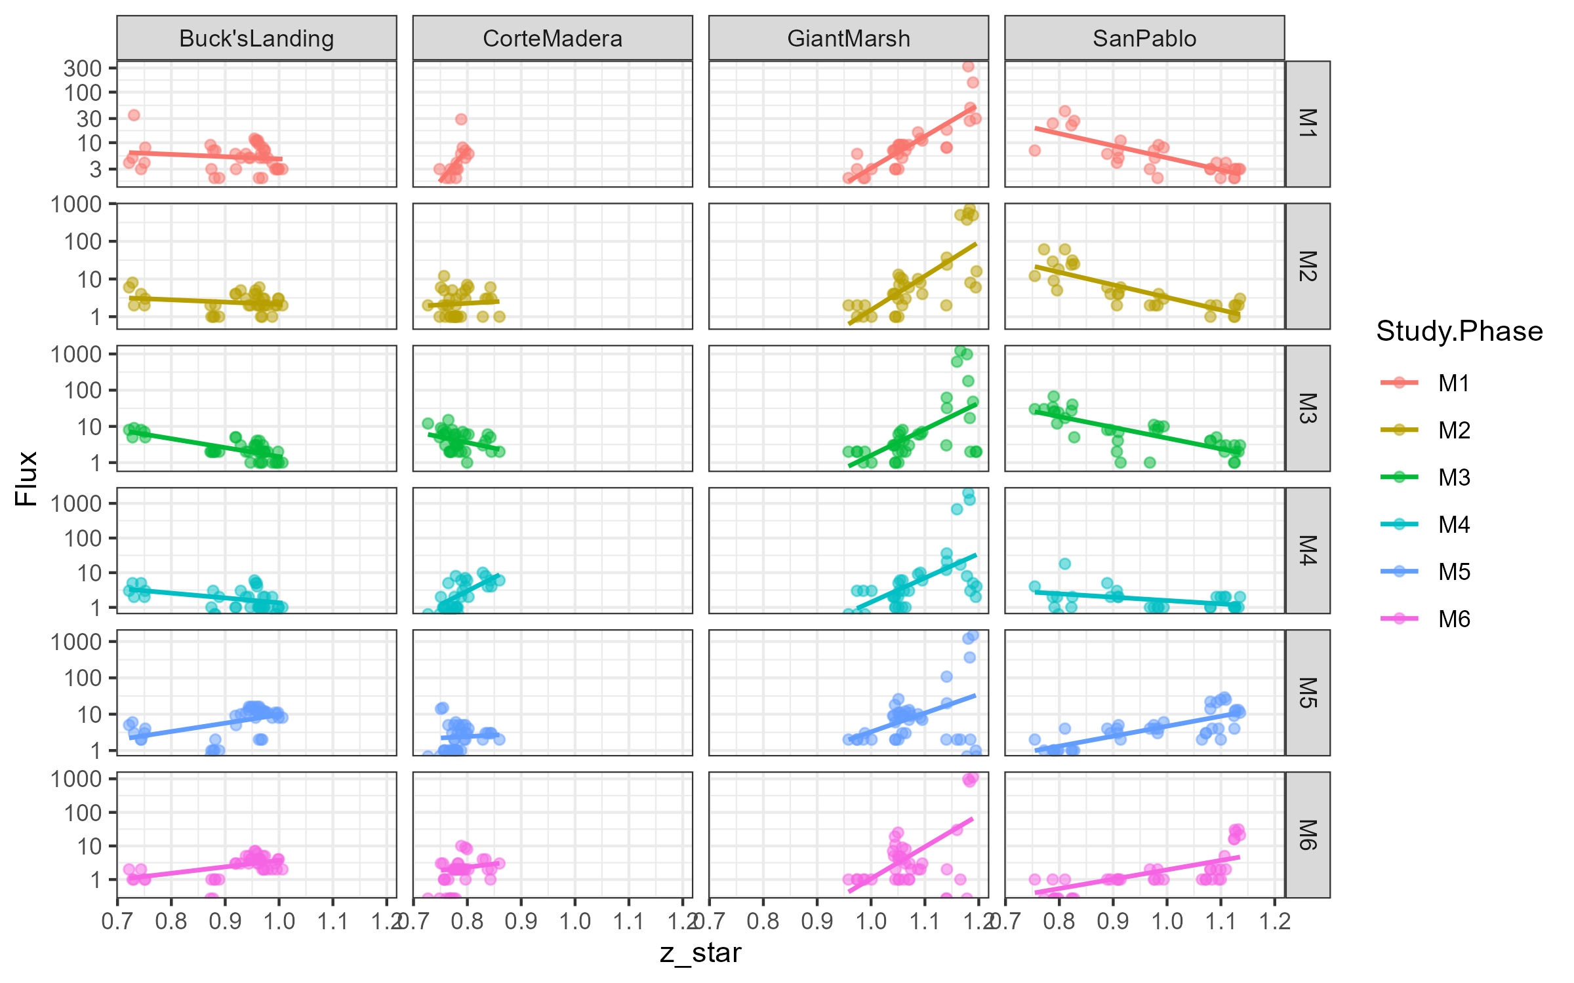

Slide 6
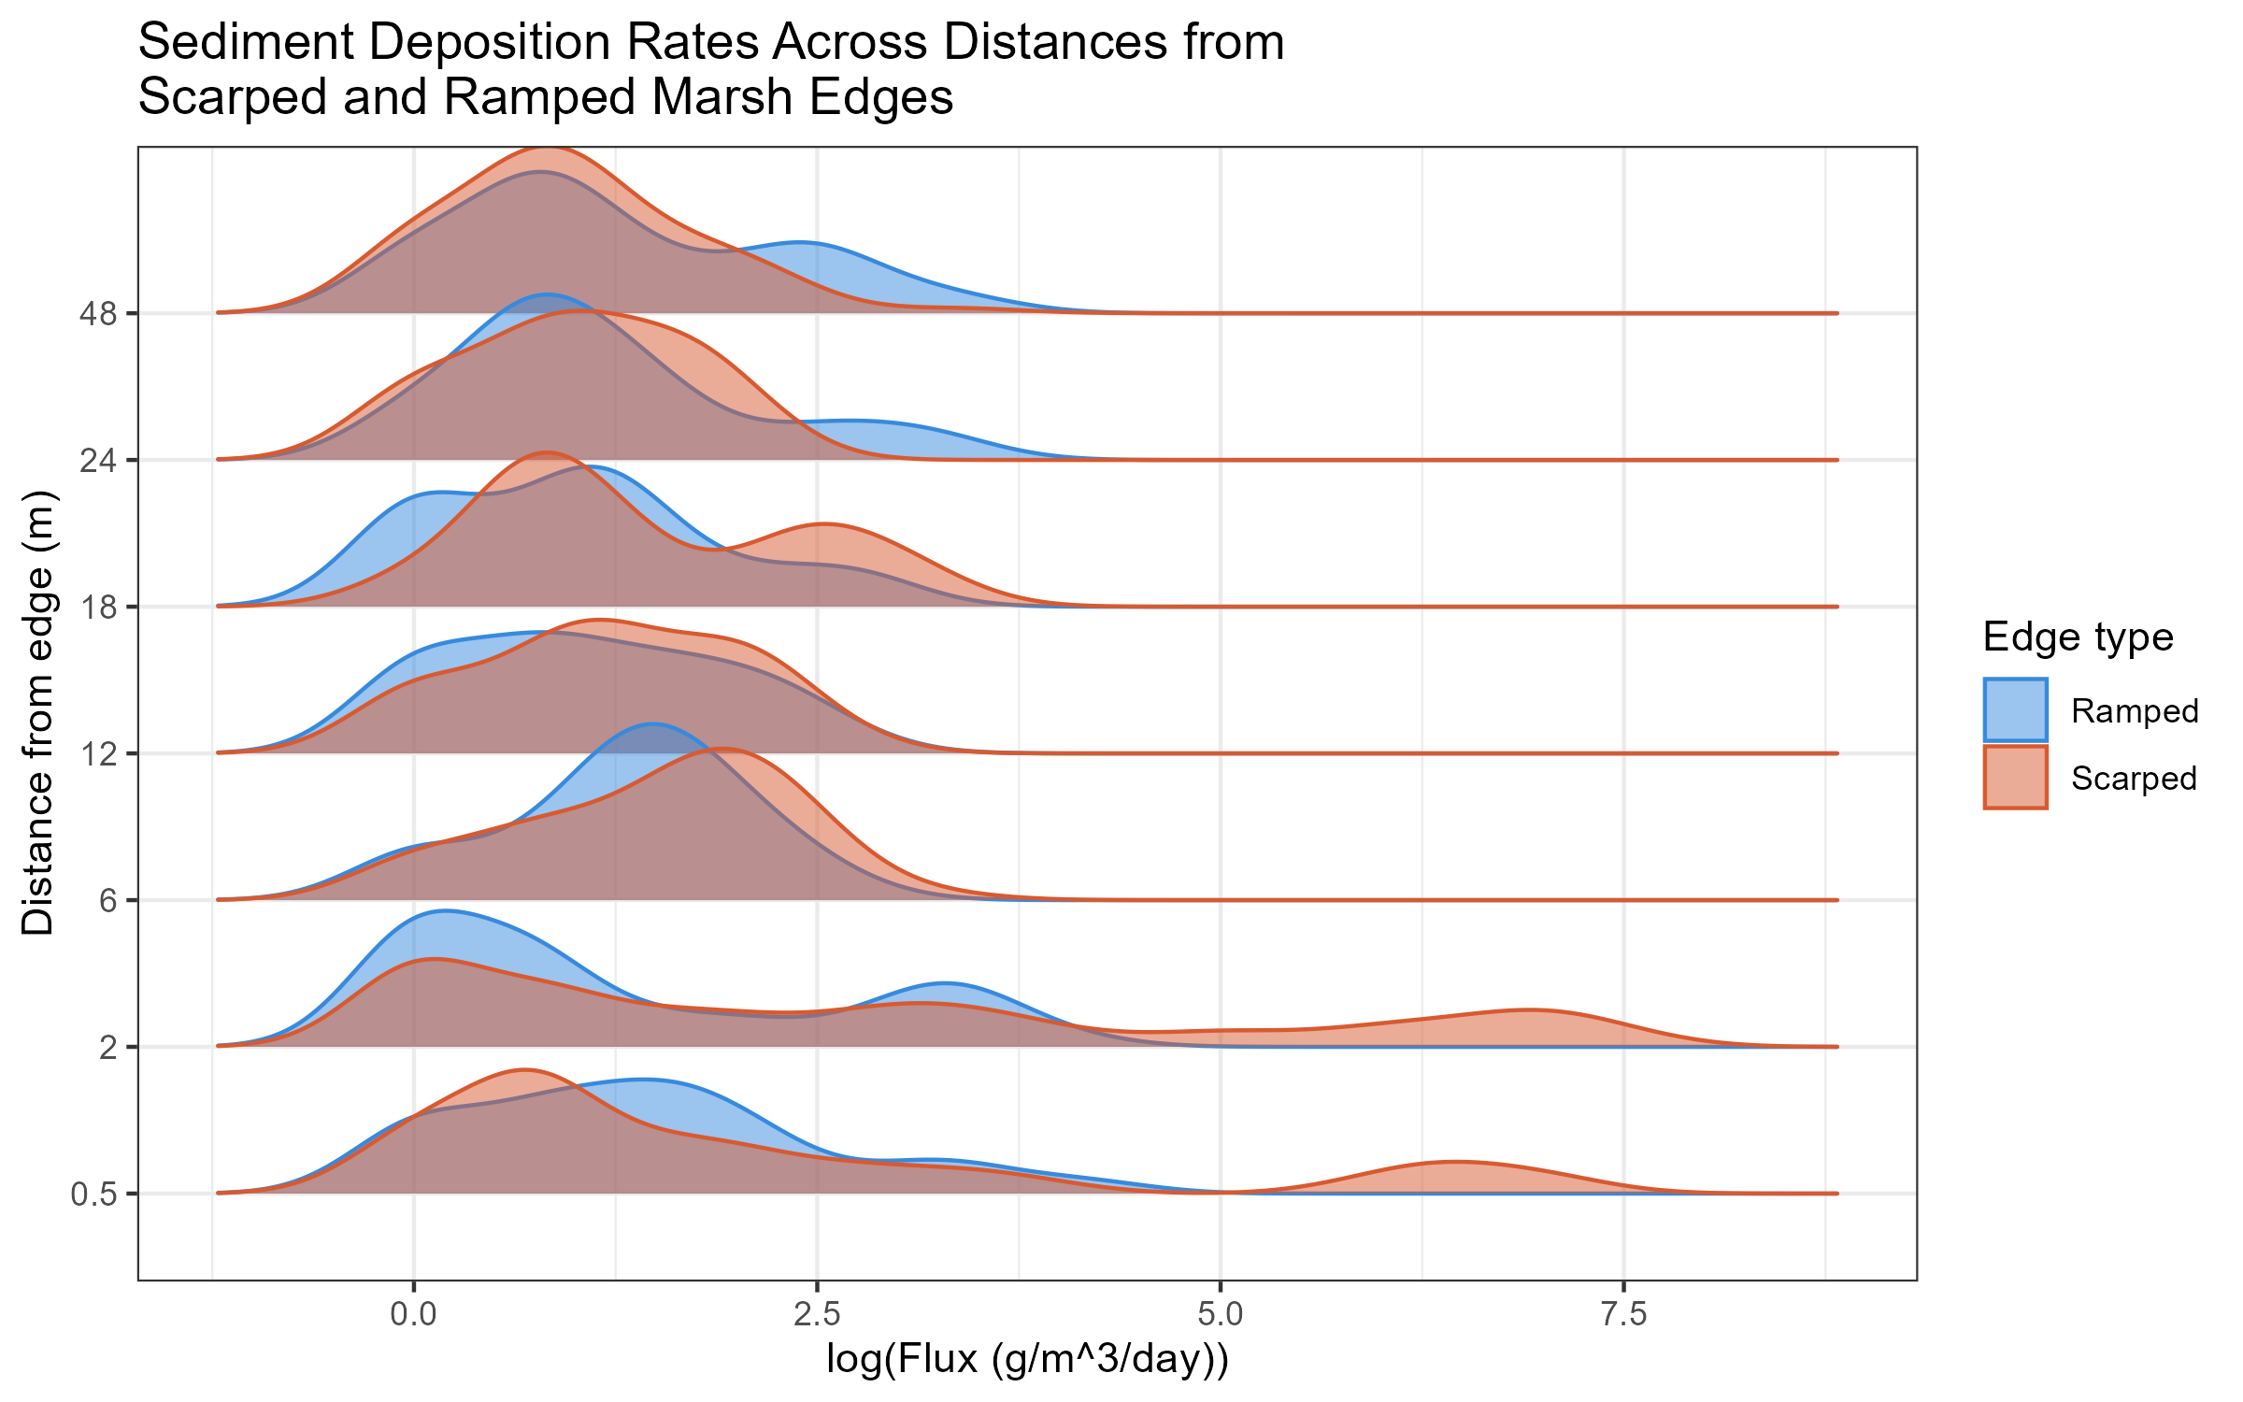

Slide 7
